Slide 1
Bengali-English Neural Machine Translation
Using Deep Learning Techniques
By Rifha Hossain Munaja
Id - 20301466
Section - 01
CSE 438
Faculty : Annajiat Alim Rasel

Slide 2
CONTENTS OF THIS PRESENTATION
Introduction
What is Neural Machine Translation (NMT) ?
Performance Metrics: ROUGE and BLEU
Data Collection & Results
Conclusion And Future Work

Slide 3
Introduction
1.It is now possible to translate from Bengali to English quite easily using neural machine translation (NMT).
2. Exploration of Four seq2Seq (Sequence to Sequence) models Seq2Seq learning using LSTM, Gated Recurrent Unit (GRU), Bidirectional LSTM (BiLSTM), and Bidirectional GRU (BiGRU) .
3.BLEU and ROUGE scores widely used for evaluating generation tasks.
4. In sequence processing, a Bidirectional GRU or BiGRU is a paradigm that comprises of two GRUs, much like a BiLSTM but with only two gates: the input and forget gates are constructed .

Slide 4
What is Neural Machine Translation (NMT) ?
Neural machine translation or NMT is the use of neural network models to learn a statistical model for machine translation.IIt represents a significant shift from previous statistical machine translation (SMT) methods, providing improvements in translation quality, fluency, and accuracy.NMT employs an encoder-decoder structure, the encoder processes the input text and compresses the information into a context vector, a high-dimensional representation of the input text and the decoder then generates the translation from this vector. NMT models represent words as high-dimensional vectors (embeddings), capturing semantic meaning and relationships between words. NMT models can operate on subword units (such as Byte Pair Encoding or SentencePiece) which helps to handle rare and out-of-vocabulary words.

Slide 5
Types Of Sequential Models
1.Long short-term memory (LSTM) networks are a form of recurrent neural network (RNN) that can learn order dependency in sequence prediction challenges. LSTM by default may maintain information for a long time by preventing information from vanishing by managing the flow of information through gates.
2.Gated Recurrent Unit (GRU) is an advanced type of RNN and a simpler form of LSTM with fewer gates.
3. A Bidirectional LSTM (BiLSTM) is a sequence processing model which consists of two LSTMs where one takes the input in a forwarding direction, while the other in a backward direction it has the ability to control the flow of information in both directions which makes it one of the most effective sequence processing models.
4. Bidirectional GRU (BiGRU) is a architecture with two GRUs in both forward and backward directions.

Slide 6
Performance Metrics: ROUGE and BLEU
ROUGE (Recall-Oriented Understudy for Gisting Evaluation):Compares automatically generated summaries or translations to a set of reference summaries. Scores are classified into ROUGE-1, ROUGE-2, and ROUGE-L, each evaluating precision, recall, and F1-score.ROUGE-N is calculated as the ratio of the number of matched n-grams between the generated summary and the reference summaries to the total number of n-grams in the reference summaries.
BLEU (Bilingual Evaluation Understudy):Purpose: Assesses the quality of machine-translated text.Scores range from 0 to 1, with higher scores indicating better translation quality. It focuses on the sufficiency and fluency of the translation, comparing it to human reference translations.Scores closer to 1 indicate greater overlap with human reference translations, implying higher translation quality.

Slide 7
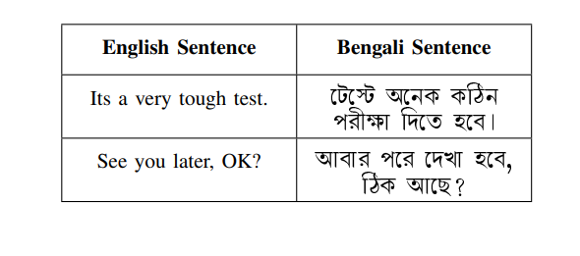
Data Collection & Results
DATA SOURCES :
Tatoeba Project, Samanantar, ALT Project, and Tico-19.
95% of the data (4943 samples) is used for training.
2. 5% of the data (261 samples) is reserved for testing.
3. Within the training set, 10% of the data (495 samples) is
set aside for validation purposes.
4. BiGRU achieved high training accuracy (95.5%) and
validation accuracy (86.4%) with fewer epochs (35).

Slide 8
Conclusion And Future Work :
In this paper, the authors achieved optimal results in translation tasks using minimal resources, demonstrating that BiLSTM outperforms other models, particularly in handling sequences of consecutive words. This performance was substantiated by ROUGE and BLEU scores, with BiLSTM scoring impressively across various BLEU metrics. However, the effectiveness of BiLSTM on larger Bengali datasets, especially those containing rare words, remains an area for future research. The paper underscores the challenges in translation, emphasizing the importance of grammatical accuracy, a rich vocabulary, and substantial computational power. In future, the authors suggest that enhancements in model performance could be achieved through the use of multiple dense layers, parameter and hyperparameter tuning, advanced computational techniques, and comprehensive Bengali-English datasets.

Slide 9
THANK YOU

